Slide 1

I am creative when I……
Notes:
Page 17….jot down in the guide

Slide 2
ENABLERS AND OBSTACLES TO CREATIVITY

Slide 3


Causes of Mental Blocks

Slide 4
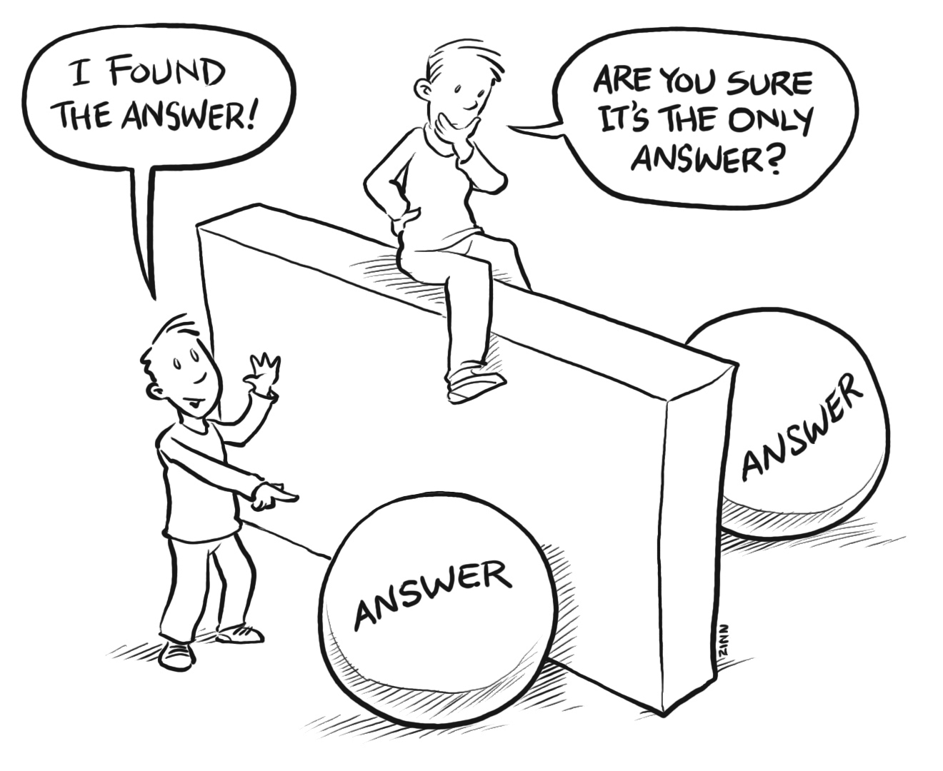
Assuming there is only one right answer.

Slide 5

Being distracted by irrelevant information, called “mental dazzle”.

Slide 6

Being too anxious to finish.

Slide 7

Getting frustrated by lack of success.

Slide 8

Perceptual Blocks

Slide 9

Emotional Blocks
Fear of risk taking
Judging rather than generating ideas

Slide 10

Environmental Blocks (Distractions)

Slide 11

Intellectual Blocks (Don’t have background knowledge)

Slide 12

Expressive Blocks (Can’t communicate easily with others)

Slide 13

Enablers to Creative Thinking

Slide 14

Keep track of your ideas at all times.
Many times ideas come at unexpected times. If an idea is not written down within 24 hours it will usually be forgotten.

Slide 15

Keep abreast of your field.
Read the magazines, trade journals, and other literature in your field to make sure you are not using yesterday's technology to solve toady's problems.

Slide 16

Have Courage and Self-confidence.
Be a paradigm pioneer. Assume that you can and will indeed solve the problem. Persist and have the tenacity to overcome obstacles that block the solution pathway.

Slide 17

Engage in creative hobbies.
Hobbies can also help you relax. An active mind is necessary for creative growth.

Slide 18

Risk Taking

Slide 19
In 1959 Xerox completed the first prototype copier and initiated work to go into mass production.

Slide 20
They found that producing high quality machines was going to require a great deal of investment.

Slide 21
Consequently they hired Arthur D. Little to carry out a marketing and financial analysis.

Slide 22
The analysis concluded that no more than 500 units would sell, which may not justify such a large capital investment.

Slide 23
The project looked like it would end before it began.

Slide 24
Fortunately, management went ahead with the risk and took on the project.

Slide 25
Ten years later Xerox passed the billion dollar ($1,000,000,000.00) mark as a result of their revolutionary office copiers.

Slide 26
In 1973,Xerox company developed the Alto System which included the:
  First Personal Computer
  First Hand-Held Mouse
  First Word Processing System For Non-experts

Slide 27
A survey showed there was not a market for personal computers (PCs).
.

Slide 28
In 1979 they decided not to take the risk and as a result did not market the Alto.

Slide 29
Epilogue
Xerox was the first to develop the PC, yet it still remains a copy company to many people, while revenues from Apple and IBM measured in the billions of dollars by 1981.

Slide 30
Never say die

Slide 31

in INDONESIA
A major marketing campaign was initiated to introduce Coca-Cola into Indonesia.

Slide 32

Indonesians tried Coca Cola and did not like it. Sales dropped off rapidly.
sales
time

Slide 33
Coca-Cola FAILED!!! But did they QUIT??

Slide 34
Indonesians were used to tea, coffee, and tropical soft drinks and were unaccustomed to carbonated drinks.

Slide 35

Coca-Cola phased in carbonation by introducing it into strawberry, pineapple, and banana flavored soft drinks.

Slide 36
The sale of Coca-Cola now surpasses the sale of local tropical drinks.

Slide 37
Bill Gates is now one of the world’s wealthiest individuals, but he didn’t earn his fortune in a straight line to success.

Slide 38
Walt Disney was told he lacked creativity.

Slide 39
Steve Jobs was booted from his own company.

Slide 40
To make a breakthrough you have got to be willing to make mistakes
Make as many mistakes as you need to learn
“Failure” is a strengthening process

Slide 41
Menlo Industries
design and build custom software.

Slide 42
Sign on the Wall
Make Mistakes Faster

